Slide 1
An Introduction to the TCP/IP Protocol Suite
The TCP/IP protocol stack
The main protocols

Slide 2
Internet IPv4
“Internet Protocol Transition Workbook”
  Was published to help the change
“The CATENET Model for Internetworking”
  Described the overall concept
“the collection of packet networks which are connected together”

Slide 3



Host
Access
Controller
= Local Gateway
Network
A
Network
B
Catenet
Gateways
Host
Internet
Datagrams
Catenet
Gateways
Host
Network
D
Internet
Datagrams
Network
C
Access
Controller
Host
Host
Host
Internet
Datagrams
Basic Catenet Model

Slide 4




Net A
G = Catenet Gateway
HG = Hidden Gateway
H = Host
G
(ax)
Net X
Net u
HG
(ur)
HG
H
(uw)
j
HG
(vw)
Net v
Net w
G
(cx)
H
g
H
Net C
k
Net B
Hidden Gateways in Hierarchical Networks
G
(bx)

Slide 5
But we now use new words
CATENET Gateways now called Routers
Local Gateways now normally just called interfaces
Hosts are still Hosts
Access Controllers are now not normally obvious as separate entities

Slide 6
The TCP/IP Protocol Stack
Four layers
Sits on top of media
Application
Transport
Network
Link

Slide 7
Where they sit in the Protocol Stack
Transport | TCP |  |  | UDP
Network | IP (Internet Protocol)
 | Traditional Ethernet ( CSMA / CD Bus)
Data Link And Physical |  | 802.2 Logical Link Control (LLC)
 |  | 802.3 CSMA / CD Bus | 802.4 Token Passing Bus | 802.5 Token Passing Ring | 802.6 DQDB Bus (MANs) | 802.9 Voice and Data LAN

Slide 8
The Application Layer
Many different applications
Standard services - telnet, ftp, http, smtp, snmp
User defined applications/protocols

Slide 9
The Transport Layer - TCP
Transmission Control Protocol (TCP)
Connection-oriented
Provides reliable data transfer
  Sequence Checking
  Retransmission of lost or errored datagrams
  Flow control
Uses ports to identify applications

Slide 10
The Transport Layer - UDP
User Datagram Protocol (UDP)
Connectionless
Unreliable
Uses ports to identify applications

Slide 11
Ports
Extra address used in conjunction with the IP Address.
The IP Address identifies the host connection.
A computer has many processes running. How do you identify which one to communicate with?
Process numbers change and are operating system dependent.
There are a set of ports (often called sockets) that applications can reference.
Some are already assigned “well known port numbers”.

Slide 12
Ports
User
Application 1
User
Application 2
User
Application 3
Port x
Port y
Port z
TCP
IP
One IP Address

Slide 13
IP - Internet Protocol - Features
IP is a connectionless datagram protocol
Connections to networks have IP addresses as well as network technology specific (MAC) Addresses
Every datagram is routed independently of the rest.
IP can lose datagrams, they can arrive in wrong order.
There is no error recovery; datagrams with a header error are just thrown away. User data is not checked.
No Flow Control
Supports broadcast and multicast as well as unicast
Often data has to be fragmented. IP does this as required.

Slide 14
The Network Layer
IP
Protocol
IP
Protocol
Internet
Protocol
(IP)
Internet
Protocol
IP
Internet
Protocol
(IP)

Slide 15
The IP Datagram
Bits
0
4
8
15
Version
Header
Length
Type of Service
Total Length
Identifier
Flags
Fragment Offset
TTL
Protocol
Header Checksum
Source Address
Destination Address
Options & padding

Slide 16
IP Version, Header Length & TOS
The first four bits contains the version of IP used (currently 4 but version 6 is defined).
Header Length is just that, in units of 32 bit words, typically 5
TOS - Type of Service
0
1
2
3
4
5
6
7
Reserved
Precedence
Delay
Reliability
Throughput

Slide 17
Fragmentation & Reassembly
IP datagrams consist of an IP Header and the data. If the data is too large to be carried across a subnetwork then it is fragmented:
IP Header
Data
IP Header
Data
IP Header
Data
IP Header
Data
IP Header
Data

Slide 18
Identifier, Flags & Fragment Offset
The Identifier is a label that is common to all fragments of one original message.
Flags are used to control fragmentation:
Bit 0 not used
Bit 1 = 0 fragmentation allowed, =1 do not fragment
Bit 2 = 0 last fragment, = 1 first or continuation fragment
Fragment Offset. Where the fragment came in the original message. Units are of 8 octets.

Slide 19
TTL & Transported Protocols
The TTL or Time to Live was originally intended to measure how long a datagram was in a network.
If a datagram took too long then it was obviously lost and should be killed.
In practice, this is used as a hop count. It is decremented by 1 at every router across a network. When the count hits zero, the datagram is dropped.
The transported protocol field indicates what is above IP.
Decimal 6 is TCP, 17 is UDP. There are around 40 defined.

Slide 20
Header Checksum and Addresses
The IP Header contains a checksum for just itself, it does not protect the user’s data at all. There is no retransmitting of bad datagrams; they are just discarded.
Addresses for the sender and destination are carried in every IP datagram. They are 32 bits in length.
An IP address can be used to route datagrams across the world. There are a number of ways of partitioning up the 32 bit address space.

Slide 21
Network Layer Addressing
IP addresses are 32 bits long
Usually represented in dotted decimal notation
Have different classes
Are mapped to/from names using DNS

Slide 22
Dotted Decimal Notation
As 32 bit numbers are people-hostile, we use a dotted decimal notation.
Take a 32 bit address:
10100101010010001111010101100101
and separate it into 8 bit groups:
10100101 01001000 11110101 01100101
Treat each of these as a decimal number:
165 72 245 101
and put dots between:
165.72.245.101

Slide 23
IP Address Classes
An IP Address does not identify a host or device directly but identifies the point of connection to the network.
IP Addresses are grouped into classes:
Class A
Class B
Class C
Class D
Multicast
0
Network(7)
Local Address (24)
1
0
Network(14)
Local Address (16)
1
1
0
Network(21)
Local Address (8)
1
1
1
0
Multicast Address (28)

Slide 24
Router Address Processing
router knows it can get to machines on directly attached networks immediately
router normally knows about the right “route” to use to get to a specific small number of networks, i.e., which router to go to next in order to get closer to destination
router normally has an entry to a “default” router (sometimes referred to as a gateway) which is used if no better route exists

Slide 25
Netmask
more sophisticated and flexible system
moves away from fixed allocation of numbers of bits to either network address or host address
the bits which are set in the netmask define the network bits, others are host bits
so, original class A corresponds to a netmask of 11111111 00000000 00000000 00000000 often written 255.0.0.0
routers and machines attached to networks where netmasks are in use need to be told about them

Slide 26
Netmask Usage
originally used to split larger networks into sets of smaller ones (called “using subnet masks”)
  say class C network 193.60.14.0
  if apply netmask of 255.255.255.192
  now have 4 networks of 64 addresses each
can also combine networks
  say class C networks 193.60.32.0, 193.60.33.0, 193.60.34.0, 193.60.35.0
  netmask 255.255.252.0 (rather than 255.255.255.0)
  have combined them into single larger network with 1024 addresses (called “using supernet masks” )
  Routing changes to “Classless Inter Domain Routing – CIDR”

Slide 27
Other Network Layer Protocols
Internet Control Message Protocol (ICMP)
Internet Group Management Protocol (IGMP)

Slide 28
The Link Layer
Token
Ring
Protocol
Ethernet
Protocol
Token
Ring
Driver
Token Ring
Driver
Ethernet Driver
Ethernet
Driver
Ethernet
Token Ring

Slide 29
IP and MAC Addresses
A MAC Address is an interface unique hardware address, 48 bits in Ethernet, usually burnt into the equipment.
If an interface card fails it is replaced. The MAC Address then changes. If the rest of the world used that address for routing then everyone would need to be updated when a card failed!
Internets use the IP address to route on; MAC adddresses are only known within their own local networks (up to the router).

Slide 30
Mapping IP to Media/Physical Level Addresses
We need to be able to convert an IP address into a local physical address that we can use
ARP and RARP are associated protocols that help us to achieve this objective

Slide 31
TCP Windowing and Acknowledgements
1 2 3 4 5 6 7 8 9 10 11 12 13 14 15 16
1 2 3 4 5 6 7 8 9 10 11 12 13 14 15 16
Sent Sent Can Beyond our
and but not Still Current Limit
ACKed ACKed Send for Sending
The size of the window can be changed by the receiver by including a new value in the header of any returned datagram. This is flow control.
The window uses bytes, not packets as some other protocols.

Slide 32
TCP Error Recovery
TCP does not have an explicit command to request retransmission of data.
A sender will retransmit if an acknowledgement is not received within a timeout period.
If a receiver has a problem it simply does not increase the acknowledgement value.
Setting the timeout value is not always straightforward.
The Round Trip Time (RTT) varies with the network, traffic, etc but is the key to setting the timer.

Slide 33
UDP - User Datagram Protocol
UDP is located at the same level in the protocol stack as TCP. UDP is a connectionless service.
no error recovery, no flow control, no indication that a datagram has been delivered.
UDP provides an unreliable mechanism for transporting datagrams between applications.
Ports (sockets) are used in UDP in exactly the same way as in TCP.
The only real value that UDP adds to IP is the multiplexing, i.e. port mechanism.
TCP and UDP are always present in implementations

Slide 34
UDP Header
Source Port
Destination Port
Length
UDP Checksum
Data

Slide 35
Some TCP & UDP Ports
This is not, by any means, a full list.
Port TCP UDP
5 Remote Job Entry
7 Echo Echo
11 Active Users
13 Daytime
17 Quote of the Day Quote of the Day
19 Character generator
20 File Transfer (Data)
21 File Transfer (Control)
67 Bootp Server
68 Bootp Client
80 Web Servers
161 SNMP

Slide 36
The Domain Name System (DNS)
Maps hostnames to IP addresses
Can also map IP addresses to hostnames
Is a distributed database of information
Runs on a client-server basis

Slide 37
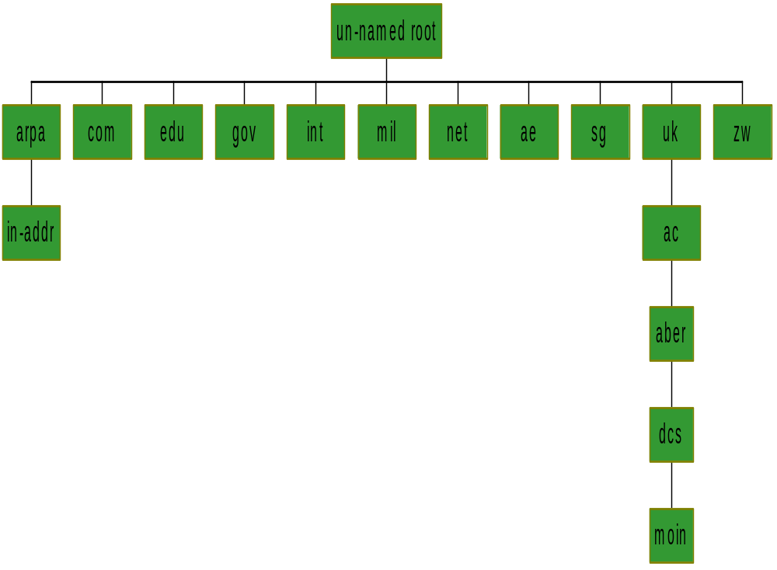
The DNS Name Space

Slide 38
Delegation of Authority
No single site manages the whole name space
Network Information Centres (NICs) maintain different top-level domains
NICs delegate authority for zones (sub-trees) to other institutions

Slide 39
Number to Name Lookups
so-called “pointer queries” support lookup of numbers to names
uses the .in-addr.arpa part of the name space
requires (separate) DNS servers to hold number to name mappings

Slide 40
Organisation of the Name Servers
An organisation with authority for a zone must provide multiple name servers for the zone
Name servers are said to have authority for one or more zones
Have primary and secondary name servers

Slide 41
Serving Information
A name server can serve information from its own zone
Can serve cached information from other zones
Can query other name servers for information it does not hold itself

Slide 42
DNS Messages
Identification
Flags
Number of questions
Number of answer RRs
Number of authority RRs
Number of additional RRs
Questions
Answers
Authority
Additional Information

Slide 43
TCP or UDP
DNS has ports registered for TCP and UDP
UDP used predominantly
TCP used in two special cases

Slide 44
DNS Local Example
Eyrie
Name server
query
saturn
ftp client
response
tcp
connection
manuel
ftp server

Slide 45
Querying Another Domain
13. ptr response
ftp server’s
name server
ftp server
8. ptr query
root
name server
9/10. ptr query/response
11/12. ptr query/response
4/5. name query/response
root
name server
2/3. name query/response
7. TCP connection
6. name response
ftp client
ftp client’s
name server
1.name query

Slide 46
Summary
This has been a very brief overview of the major IP Protocols.
There are many other protocols used in the Internet. These are for:
  Routing: You may know a remote address but how do you know which path to take?
  Reporting problems on remote networks.
  Managing the LAN/WAN subnetworks.

